Slide 1
Artificial Intelligence

Slide 2
Outline
Problem Solving
Problem solving approaches
Problem Representation
Components of problem solving
Problem description
The two-one puzzle problem
Problem solving by searching
Searching and Categories of the search algorithm
Graph theory and tree

Slide 3
Problem ??
What is it?

Slide 4
Problem ??
a problem occurs if a person does not know how to proceed from a given state to a desired goal state.
Thus, a problem is described by three components: (1) a given initial state s_{α};
(2) a desired final state s_{ω}; and
(3) a barrier which hinders the solution of the problem, that is, to come from s_{α} to s_{ω}.

Slide 5
Problem ??
A clear statement describing the initial state of a problem that's to be solved.

Slide 6
Problem Solving
We want:
To automatically solve a problem
We need:
A representation of the problem
Algorithms that use some strategy to solve the problem defined in that representation

Slide 7
Problem Solving Approaches
Classical
Generate and Test

Slide 8
Classical Approach
A simple approach to solve the problem
Hit and trial method
Check for various solutions to a problem
Usually works well for trivial (small) problems
Examples:
Maze (path or collection of paths) searching problem (Mouse example)
A toddler to switch on the light in a dark room
To open a combinational lock of a briefcase
Different intelligent species use a similar approach to solve the problem at hand

Slide 9
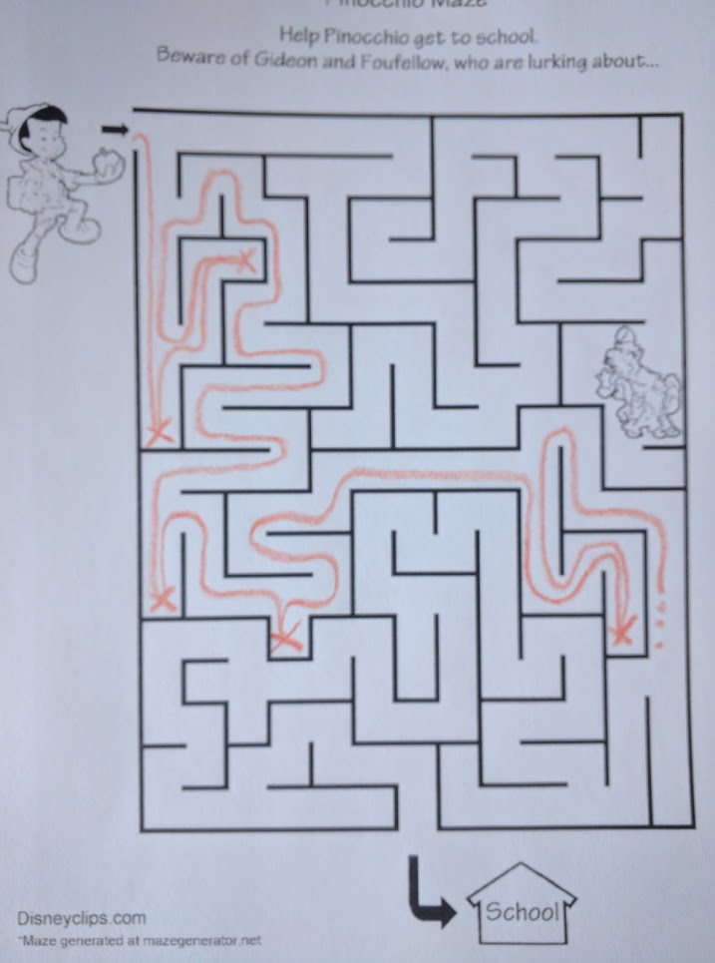
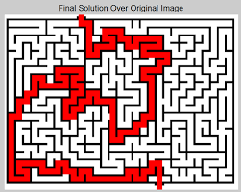
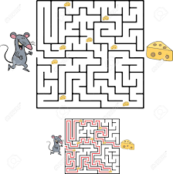
Maze search problem

Slide 10
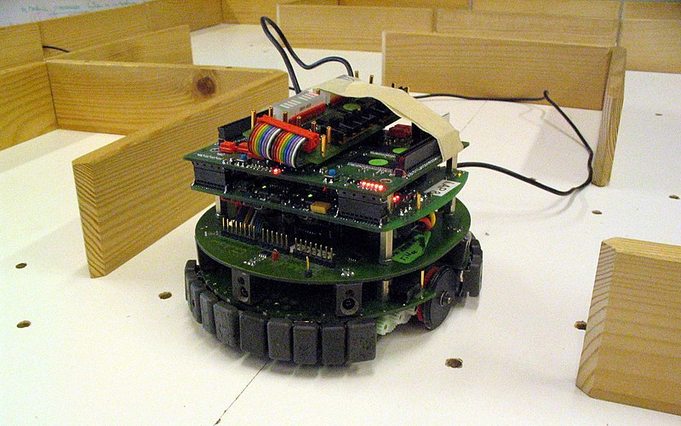
Maze search problem

Slide 11
Generate and Test Approach
This technical “hit and trial approach” to solve the problem is called the “Generate and Test” approach.
It is a heuristic search technique
Generate different combinations to solve the problem
The one which solves the problem is taken as the correct solution.
The rest of the combinations are considered as incorrect solutions and hence are destroyed.

Slide 12
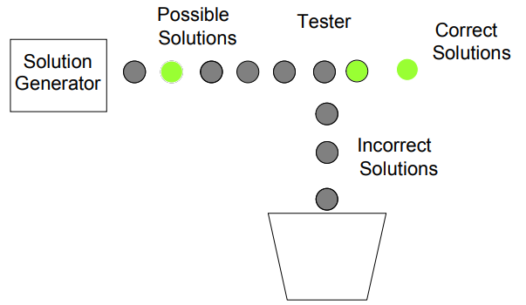
Arrangement of a Generate and Test
Mouse Example (maze searching problem):
Solution generator (can say it as algo.): a machine that generates different paths inside a maze
Tester: whether a path is a valid path for the mouse to reach the cheese

Slide 13
Arrangement of a Generate and Test
Genetic Algorithm is also an example of it.

Slide 14
Problem Representation
To solve a complex problem, some techniques better than simple Generate and Test approach are required.
For developing techniques to systematically solve the problem:
we need to know about problem representation.
A good representation of a problem is the key to problem solving
Use graphs and diagrams to develop a clear picture of the problem in your mind. (it can be like SE process)

Slide 15
Components of Problem Solving

Slide 16
Components of Problem Solving
Problem statement
State space
Successor Function
Problem Solution

Slide 17
Components of Problem Solving
Problem statement
What exactly the problem is? (example of employee attrition)
What is to be done?
What is initial state (starting point) and Final state (goal state)
A state is a representation of some elements at a given moment
What are the constraints?
Time, Available resources,
Any other rules to solve the problem?

Slide 18
State Space
Set of all possible states reachable from the initial state.
It forms a graph (or map) in which the nodes are states and the arcs between nodes are actions.
A path in the state space is a sequence of states connected by a sequence of actions.

Slide 19
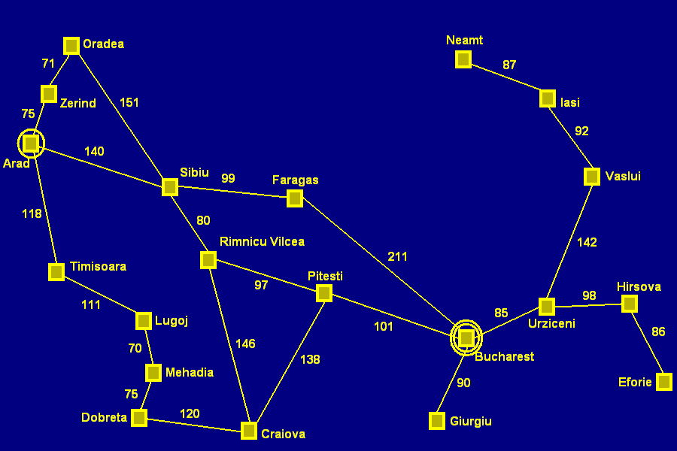
Contd..
What additional information does one need?
A map

Slide 20
State Space
The solution of the problem is part of the map formed by the state space.
Solution space: A set of the start state, the goal state and all the intermediate states

Slide 21
Successor Function
A successor function is needed to move between different states.
A successor function is a description of possible actions at any state i.e. a set of operators.
A transformation function: function on a state, which convert it into another state.

Slide 22
Problem solution
A solution in the state space is a path from the initial state to a goal state or, sometimes, just a goal state.
Path/solution cost: function that assigns a numeric cost to each path i.e. the cost of applying the operators to the states
Solution quality is measured by the path cost function, and an optimal solution has the lowest path cost among all solutions.
Notes:
What will be the ultimate goal (target) or the output of our procedure in order to solve the problem

Slide 23
Problem Description

Slide 24
Problem Description
Components
State space
Initial state
Goal state (or the conditions it must fulfill)
Available actions (operators to change state)
Restrictions (e.g., cost)

Slide 25
Examples

Slide 26
Example: 8-puzzle
1
2
3
4
5
6
7
8

Slide 27
Example (Contd..)
State space
Configuration of the eight tiles on the board
Initial state
Any configuration
Goal state
Tiles in a specific order
Operators or actions
Condition: the move is within the board
Transformation: blank moves Left, Right, Up, or Down
Solution:
Optimal sequence of operators

Slide 28
Example 2: Holiday in Romania
Currently in Arad (city in Romania)
Flight leaves tomorrow for Bucharest (Romania Capital) at 13:00
Let’s configure this to be an AI problem
Notes:
Bucharest => the capital and largest city of Romania
Arad => City in Romania

Slide 29
Contd..
What’s the problem?
Accomplish a goal
Reach Bucharest by 13:00
So this is a goal-based problem
What qualifies as a solution?
You can/cannot reach Bucharest by 13:00
The actions one takes to travel from Arad to Bucharest along the shortest (in time) path

Slide 30
More concrete problem definition
A state space
Which cities could you be in?
An initial state
Which city do you start from?
A goal state
Which city do you aim to reach?
A function defining state transitions
When in a city the following cities can be reached (available options)
A function defining the “cost” of a state sequence
How long does it take to travel through a city sequence?

Slide 31
Contd..
What additional information does one need?
A map

Slide 32
Task
Describe the problem using components discussed previously.
Evaluate all the possible paths and also find the optimal solution.

Slide 33
Solutions to Problem Solving Searching

Slide 34
Searching
To solve this problem, we need to start from a start state and search for a goal state by traveling through a solution space.
Searching is a formal mechanism to explore alternatives

Slide 35
Contd..
What additional information does one need?
A map

Slide 36
Searching
Most of the solution spaces, for problems, can be represented in a graph
where nodes represent different states and edges represent the operator which takes us from one state to the other
So, searching techniques in graphs and trees are important to understand for solving a problem in an efficient manner.

Slide 37
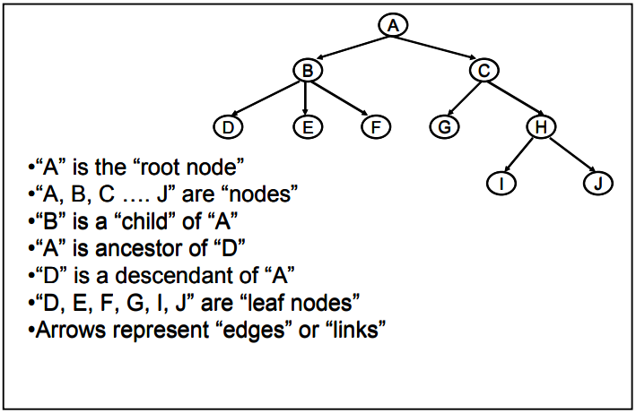
Tree and Graphs Terminology
Basics of graphs and trees
Notes:
The diagram above is just to refresh your memories on the terminology of a tree.

Slide 38
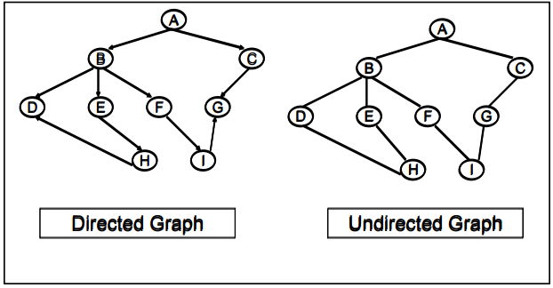
Contd..
Graphs can be directed or undirected

Slide 39
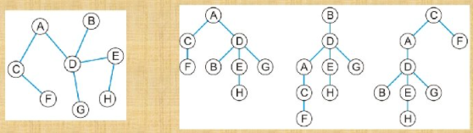
Contd..
graph can be converted into a tree, by replicating the nodes

Slide 40
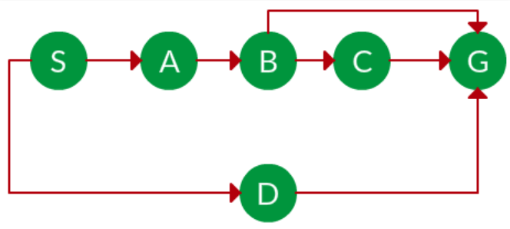
Task
Convert the graph into a tree.

Slide 41
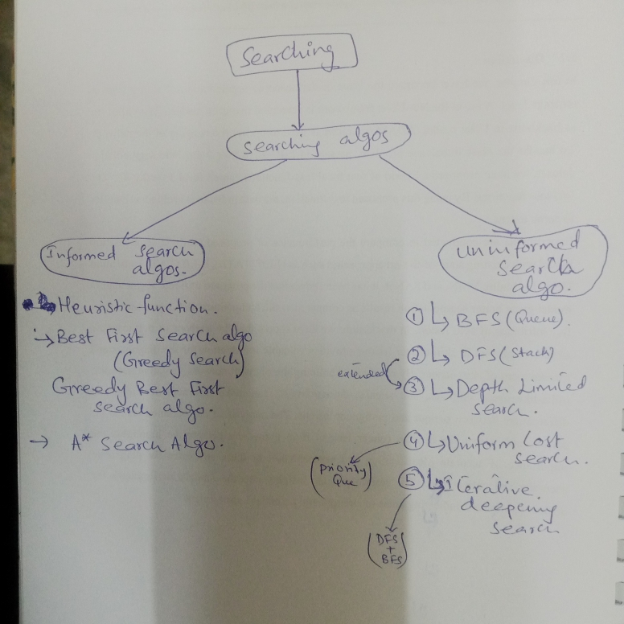
Task

Slide 42
Categories of the search algorithm
Search Strategies can be broadly classified into two categories:
Uninformed/ Blind search algorithms
Hit and trial approach
Informed/ Heuristic search algorithms
Guided search
Path/non-optimal search algorithms
Optimal path search algorithms
Example: Mouse to find the path in maze

Slide 43
Uninformed Search Algorithms
Use only information available in the problem definition
Search is carried out without any additional information (except that is provided in problem definition)
How to traverse the tree, how to identify leaf and goal nodes
Solution cost is not considered
Breadth-first search
Depth-first search
Depth-limited search
Uniform-cost search
Iterative deepening search

